Slide 1



Auto-Learn
CSE 3310-004 - Spring 2020
Term Project - Team 2
Team Members:
Ryan Laurents
Edrik Aguilera
William Anderson

Slide 2
Project Topics
Project Overview
Business Objectives
System Objectives
Assumptions and Constraints
Project Schedule
UML Diagrams
Challenges
Demos

Slide 3
Project Overview
Team 2 has been employed to design and implement a software application for vehicle recognition. This Android application should allow their customers to upload their own photo or allow for a photo to be taken using the camera. Auto-Learn will take that photo and classify it using our machine learning model. The system will be up and operational during the last week of April 2020 just in time for new vehicles coming out for the 2021 model year.

Slide 4
Business Objectives
Member Registration
Login Functionality
Account Maintenance
Classification for six types of vehicles. [SUV, Truck, Coupe, Convertible, Sedan, Van]
Statistics
Upload or take a photo
Password Recovery

Slide 5
System Objectives
Android Application
Python/Tensorflow for ML
Firebase for login functionality and model training
Java/Android Studio for App
Google’s material design
App will save data while open or when account information is persistent

Slide 6
Assumptions and Constraints
Assumptions
Constraints
Ignore collecting money from external advertisement and general accounting
Ignore compliance issues
Ignore market conditions and demands
Ignore future system additions
Team lacks Android experience
Team lacks Python experience
Team lacks Tensorflow experience
Team has limited Java experience
Aggressive schedule

Slide 7
Project Schedule
Task/Milestone | Start Date | End Date | Status
Requirements/UML | 01/31/2020 | 02/21/2020 | Complete On Time
SRA Document | 03/05/2020 | 03/31/2020 | Complete On Time
Home Screen D/I* | 03/31/2020 | 04/15/2020 | Complete On Time
Login D/I* | 03/31/2020 | 04/15/2020 | Complete On Time
Set up Jupyter for ML | 03/31/2020 | 04/02/2020 | Complete On Time
Test Case/Code Review | 03/31/2020 | 04/29/2020 | Complete On Time
Finish Training Model | 03/31/2020 | 04/15/2020 | Completed Late (04/29)
External Documentation | 04/20/2020 | 04/29/2020 | Complete On Time
Project Presentation | 04/28/2020 | 04/29/2020 | Complete On Time
Project Delivery | 04/30/2020 | 04/30/2020 | Complete On Time
* Design and Implementation

Slide 8
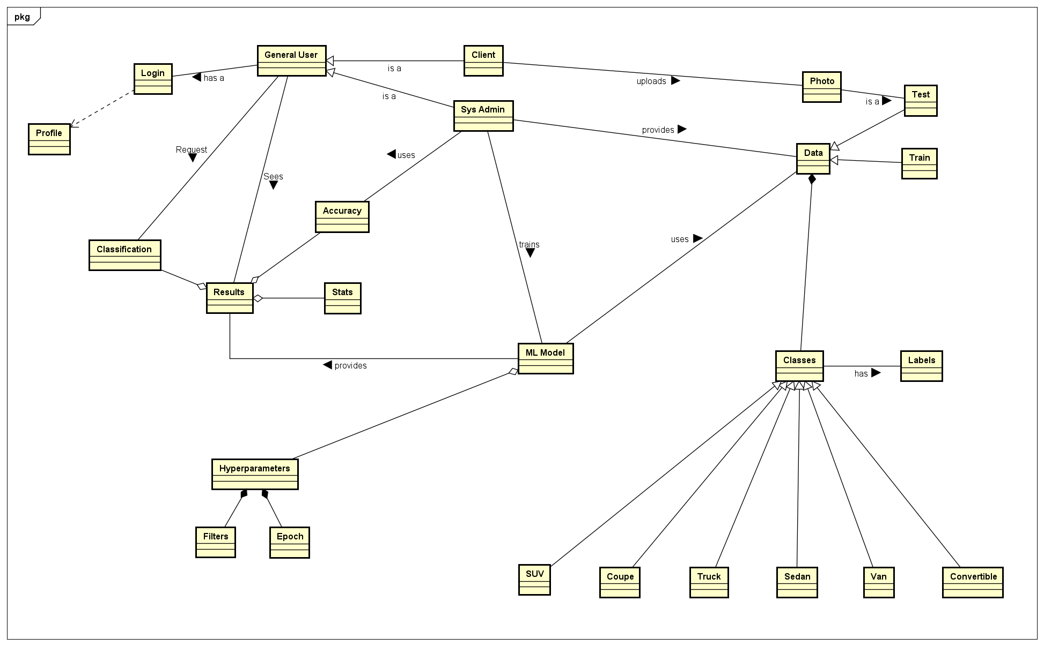
UML Diagrams – Class Diagram

Slide 9
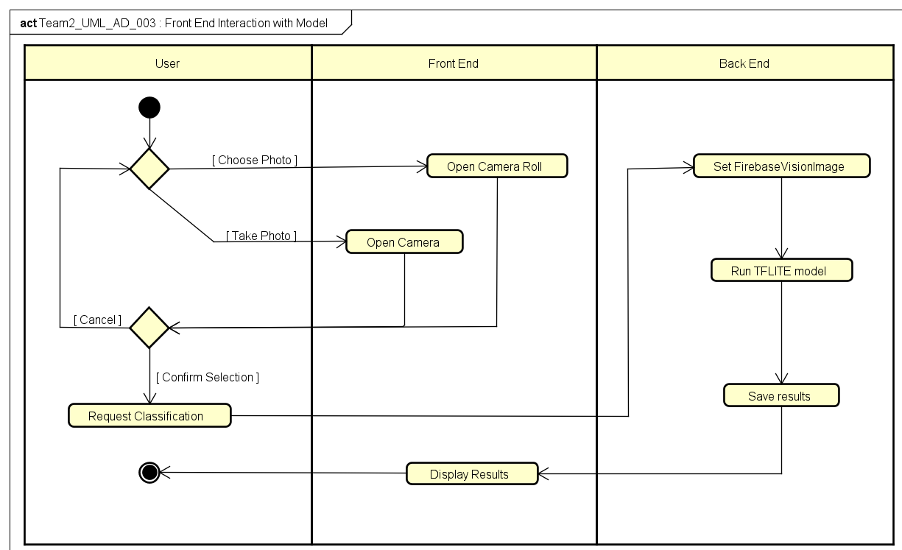
UML Diagrams – Front End Interaction with Model

Slide 10
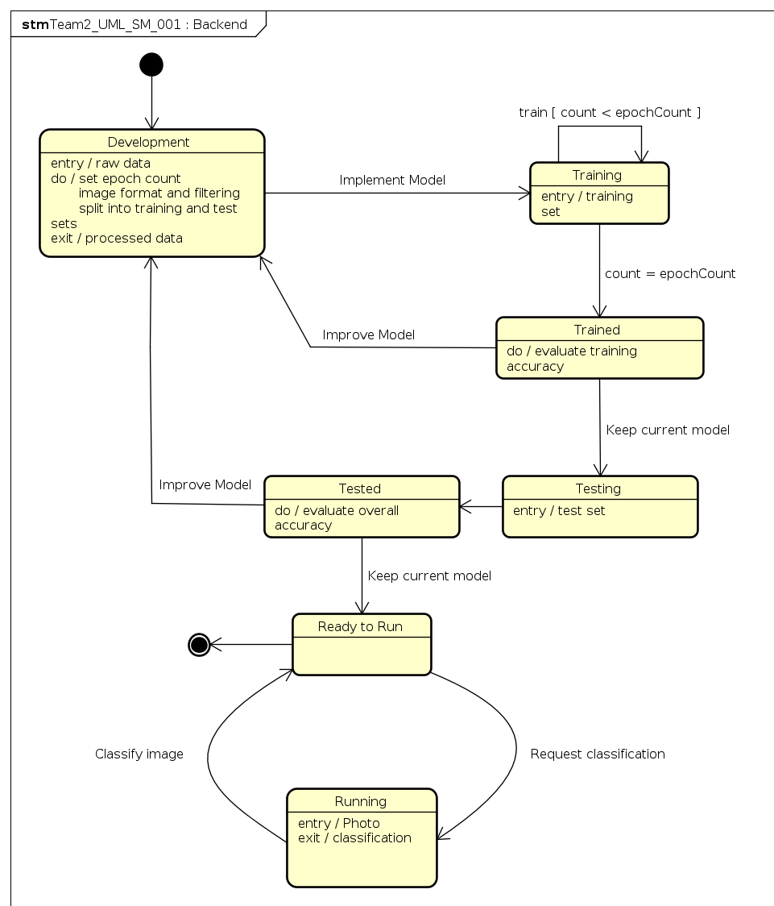
UML Diagrams – Back End

Slide 11
Challenges Faced

Slide 12
Demos

